Slide 1
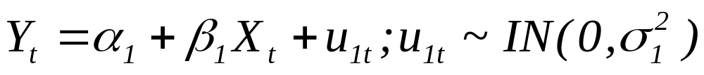
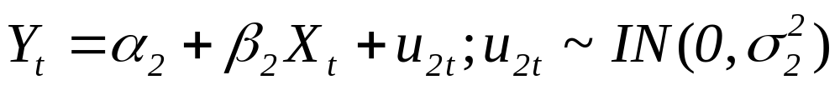
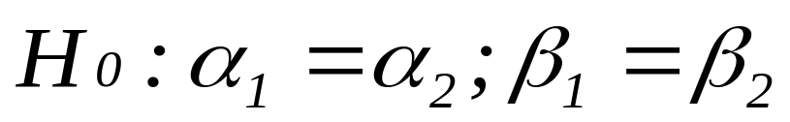
Tests for Stability
Tests for Stability - Testing constancy of parameters
Two Tests:
(i) Analysis of Variance Test (Chow Test)
(ii) Predictive Tests
The ANOVA Test:
Two regression equations for two data sets
First Set:
Second Set:

Slide 2
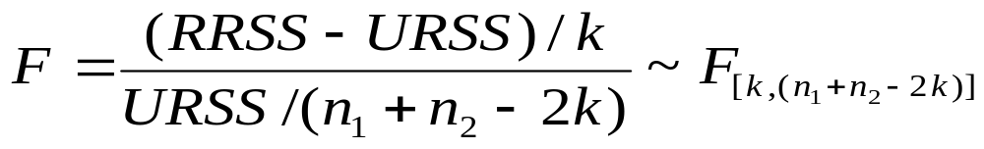
Tests for Stability
If H₀ is not rejected – Stability of parameters
Estimation of single equation for the entire dataset by pooling the two
Test Statistic:
K = No. of parameters estimated (incl. intercept)
RRSS – Restricted residual sum of squares
URSS – Unrestricted residual sum of squares

Slide 3
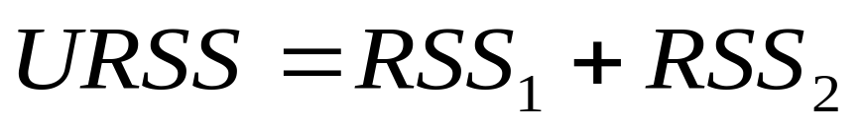
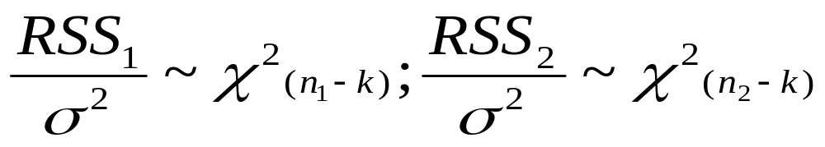
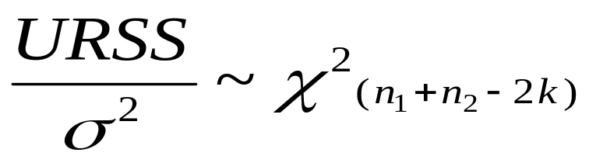
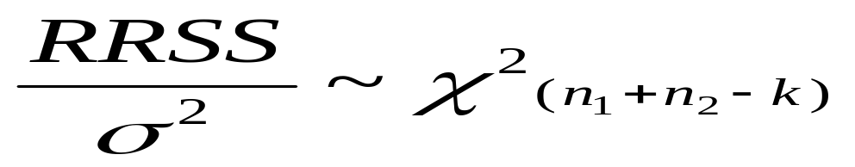
Tests for Stability
Now,
RSS₁ = RSS for first data set
RSS₂ = RSS for the second data set
Hence,
RRSS – For regression with pooled data

Slide 4
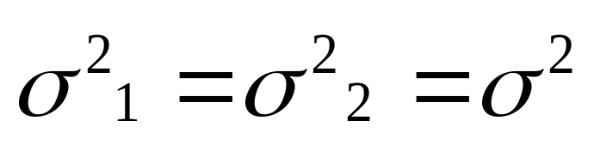
Tests for Stability
Limitations of Chow Test:
Based on the assumption that
Only tells if the two regressions are different
No clue about whether the difference is on account of the intercepts, or the slopes, or both
Sensitive to the choice of the structural breaks
Cannot be applied if n₁ or n₂ is less than k

Slide 5
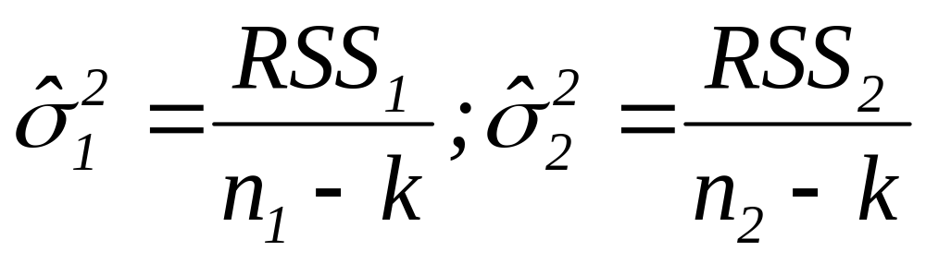
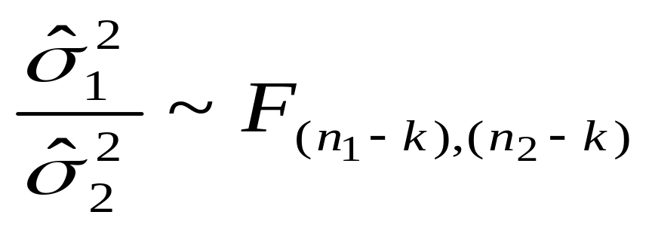
Tests for Stability
Test for Equality of Variance:
Test Statistic:
If variances are statistically significantly different,
Chow test can not be carried out

Slide 6
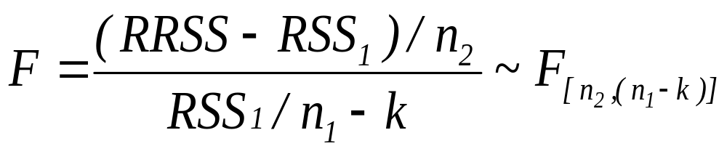
Tests for Stability
The Predictive Test:
Can be used when n₁ or n₂ is less than k
Test Statistic:
If computed value of F-stat is greater than the critical value for the given the degrees of freedom and at the chosen level of significance, the null hypothesis is rejected.
Indicates structural change in the relationship

Slide 7
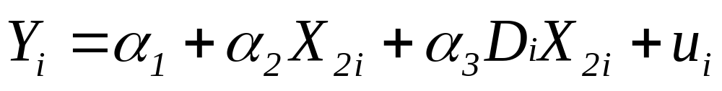
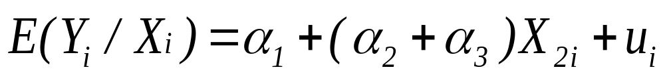
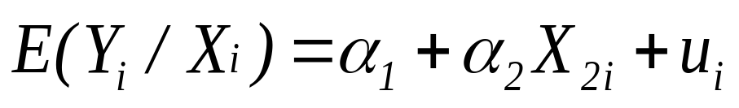
Dummy Variable Regression
Model II:
Y_{i} = Wage Rate; X₂ = Productivity
X₃= 1 for male, 0 for female – Dummy Variable
For Male:
For Female:
α₃ indicates the difference in change in mean wage rate between male and female with change in X₂
If α₃ is statistically significant, there is difference in change in the mean wage rate between male and female with change in X₂

Slide 8
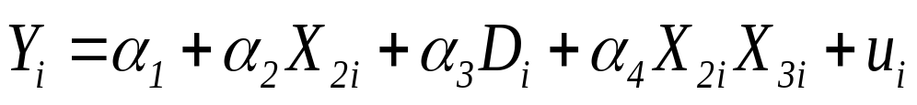

Dummy Variable Regression
Model III:
Y_{i}=Wage Rate; X₂=Productivity
D_{i}= 1 for male, 0 for female – Dummy Variable
For Male:
Fore Female:
α₃ and α₄ indicate difference in mean wage rate between male and female
Statistical Significance | Implications
α₃ | Difference in Intercept
α₄ | Difference in Slope
α₃ and α₄ | Difference in both

Slide 9
Dummy Variable Regression
Testing Stability
Regression Lines | Nature
Two regression lines with same intercept and slope | Coincident Regressions
Two regression lines with different intercept but same slope | Parallel Regressions
Two regression lines with different slope but same intercept | Concurrent Regressions
Two regression lines with different intercept as well as slope | Dissimilar Regressions

Slide 10
Dummy Variable Regression
Parallel Regression Concurrent Regression
E(Yi/Xi) E(Yi/Xi)
Xi Xi
(Same slope different intercept) (Same intercept different slope)
Dissimilar Regression Coincident Regression
E(Yi/Xi) E(Yi/Xi)
Xi Xi
(Different slope and intercept) (Same slope and intercept)

Slide 11
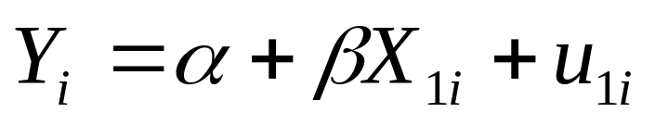
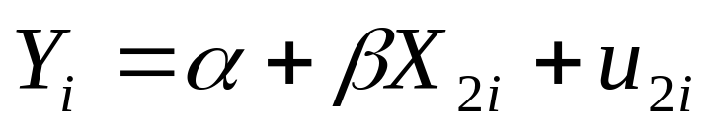
J-Test
Applied to compare two different models with exactly the same dependent variable and at least one different explanatory variable
Helps in examining if any of the models is superior to the other
Model-I:
Model-II:
Steps:
Estimate Model-I and obtain fitted value of Y

Slide 12
J-Test
Use fitted value of Y as an explanatory variable in estimation of Model-II
Examine the t-statistic for the fitted value
Repeat the steps for Model-I
Decision Rules:
 | Fitted Y of Model-I in Model-II
Fitted Y of Model-II in Model-I | P < 0.10 | P > 0.10
P < 0.10 | Combined Model | Model-II
P > 0.10 | Model-I | Either Model

